Slide 1
Cybersecurity as a
Business Differentiator
February 28, 2017
Presented by
Susan Whittemore
VP, Enterprise Cybersecurity
Fidelity Investments

Slide 2



Susan Whittemore
VP, Consulting, Enterprise Cybersecurity
Profile
Joined Fidelity in 2007
Leads a security consulting team serving the enterprise
Manages the information security office for several business units
Over 20 years in the cybersecurity field
Previous Positions
Senior-level cybersecurity positions at:
Previous positions in audit, accounting, and operations management
Education
BS Business Administration
Worcester State University

Slide 3




























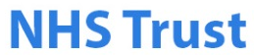
Strategic Forces Shaping Cyber
Significant Cyber Events in 2016
2016
Events
Infrastructure & Government
Social
Media
Healthcare
Business
Hospitality

Slide 4




The Threat Landscape
  Impact: Competitive advantage, trade secret disclosure, operational disruption, brand and reputation
  Motivation: Personal advantage, monetary gain, professional revenge, patriotism
  2017 Outlook: More organizations will implement insider threat mitigation programs and processes
  Impact: Costly regulatory inquiries and penalties, consumer and shareholder lawsuits, loss of consumer confidence
  Motivation: Financial gain
  2017 Outlook: Cyber-extortion
  will continue to rise
  Impact: Disruption of business activities, brand and reputation, loss of consumer confidence
  Motivation: Negatively impact reputation, drive attention to a cause, pressure for change
  2017 Outlook: Expected to escalate attack methods with high-profile data breaches
  Impact: loss of competitive advantage, disruption
  to critical infrastructure
  Motivation: Economic, political, and/or military advantage
  2017 Outlook: Will continue to strengthen their defensive and offensive cyber skills

Slide 5
Cybersecurity
The cost and risks of cyber attacks are increasing
Cyber Threat Landscape
  Cybersecurity events and costs are increasing:
    79% of survey respondents detected a security incident in the past 12 months¹
    Average total cost of a data breach increased 23% over the past two years²
    Average cost paid for each lost / stolen record increased 6%¹
Industry Outlook
Data breaches are expected to reach $2.1 trillion globally by 2019³
  76% of survey respondents¹ were more concerned about cybersecurity threats than in previous 12 months:
  Increase from 59% in 2014
Reputational Risk
An IT security breach can have serious implications in how a company is perceived:
  46% of companies suffered damage to reputation & brand value due to a security breach⁴
  19% of companies suffered damage to reputation & brand value due to a third-party security breach
  or IT system failure⁴
The risk of losing customer trust is significant and rising:
  82% of customers would consider leaving an institution that suffered a data breach⁵
Source: ¹U.S. State of Cybercrime Survey, ²Ponemon Institute, ³Juniper Research , ⁴Forbes

Slide 6
Cybersecurity
A critical part of a company’s business strategy
Board level engagement, business driven strategy
Risk based approach is key — threats vary according to industry, but all industries
are vulnerable
As technology advances, so do the threats; it is harder than ever to protect business processes and information
Compliance and regulatory requirements are a factor
Strategy must be consumable and scalable
  The U.S. Government has identified cybersecurity
  as “one of the most serious economic and national security challenges we face as a nation”¹
Source: ¹U.S. White House Office

Slide 7
Cybersecurity = Trust = Business Value
Cyber is a compelling business differentiator
Safeguarding intellectual property, financial information, and a company’s reputation is fundamental to business strategy
Clients expect their data and their assets to be secure, and services to be available
Cyber is not just about technology, it’s also about people and processes
A diverse and talented workforce can be the difference between cyber being viewed as a technology solution or as a business differentiator

Slide 8
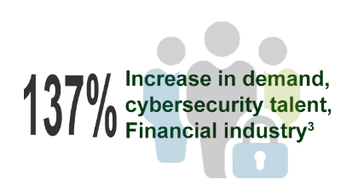
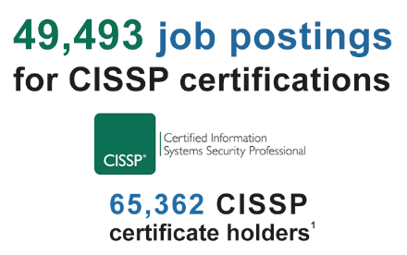
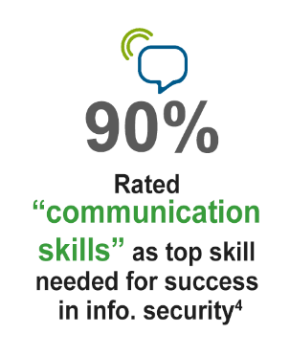
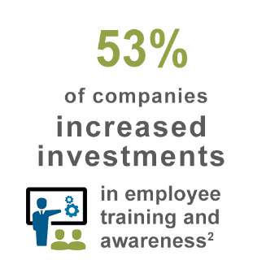
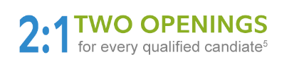
1 million cybersecurity job openings globally in 2016*
8
*Cisco, 2016; 1Information System Security Certification Consortium, 2015;PricewaterhouseCoopers, 2015; Burning Glass, 2015; ISC2, 2015; Cybersecurity Ventures, 2016

Slide 9
Tips for Success
Be opportunistic and persistent
Consider your brand
Develop expertise
No excuses!

Slide 10
Questions

